Slide 1
Household Electricity Consumption Analysis, Clustering and Forecasting
Clustering Household Electricity Consumption Patterns, Then Forecasting What Comes Next
Unsupervised Learning · K-Means, Hierarchical, GMM on Kernel PCA features
Time-Series Forecasting · ARIMA, SARIMA modelling of hourly Global Active Power
Individual Household Electric Power Consumption Dataset · Project Summary

Slide 2
PROBLEM STATEMENT
Household electricity consumption data contains complex usage patterns that are difficult to identify using traditional analytical methods. Without understanding these consumption regimes or accurately forecasting future electricity demand, utility providers may struggle to optimize energy distribution, manage peak demand, and develop targeted energy conservation strategies. This project addresses these challenges by applying machine learning techniques to identify distinct household consumption patterns through clustering and by using time series forecasting to predict future electricity consumption.

Slide 3


Two Questions, One Dataset
Four years of minute-level household power readings hide different usage regimes and a predictable near-term rhythm. This project uncovers both.
1. Clustering
2. Forecasting
What distinct electricity consumption regimes exist in the household's behaviour?
Given the historical pattern, what will Global Active Power look like next?
Reduce 7 correlated features with PCA & Kernel PCA
Test stationarity (ADF) and seasonality (STL)
Compare K-Means, Hierarchical & Gaussian Mixture
Fit and compare ARIMA vs. SARIMA(1,0,1)(1,0,1,24)
Label clusters as Very Low → High usage regimes
Validate the winning model with residual diagnostics
2

Slide 4




DATA PREPARATION
From Minute-Level Readings to a Clean Hourly Series
Raw Data
Missing Values
Hourly Resampling
Scaling
2,075,259 minute-level readings (Dec 2006 – Nov 2010), 7 numeric power & sub-metering features, loaded from the UCI household power archive.
Gaps filled with time-based interpolation on the datetime index, preserving the underlying temporal pattern rather than a flat fill.
Averaged to hourly frequency for tractable modelling, then checked for outliers via boxplots and feature distributions via histograms.
All 7 features standardized with StandardScaler so no single variable (e.g. Voltage) dominates distance-based clustering.
3

Slide 5

FEATURE ENGINEERING
PCA and Kernel PCA Prepare the Ground for Clustering
Linear PCA
Kernel PCA (RBF)
Retaining components that explain 95% of variance reduced the feature space from 7 to 5 dimensions, removing redundancy among correlated readings (e.g. power vs. intensity).
An RBF-kernel projection into 5 nonlinear components captured curved, non-linear structure in usage behaviour that linear PCA could not see.
7 → 5
features retained
(95% variance)
Selected as the input space for all three clustering algorithms, since it revealed clearer group separation than linear PCA.
Used for exploratory visualization of consumption structure.
4

Slide 6
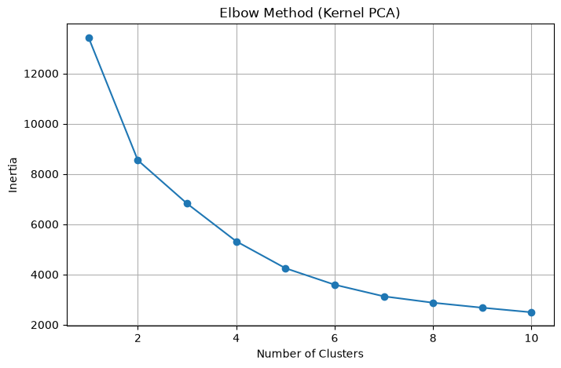
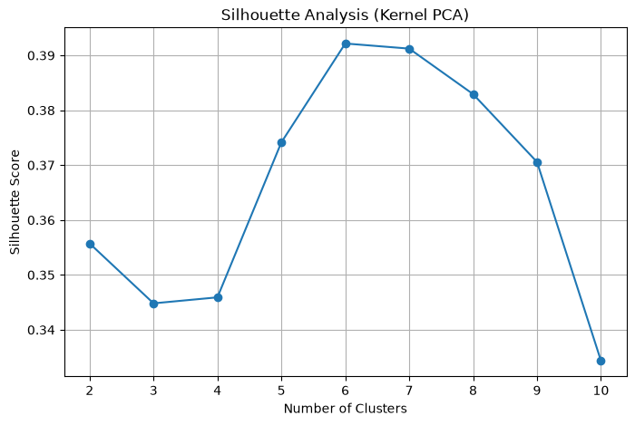
CLUSTERING — MODEL SELECTION
How Many Consumption Regimes Are There?
Elbow Method
Silhouette Analysis
Both diagnostics point to a natural break around k = 6 broad regimes — the final model then splits these further into 6 fine-grained clusters for richer profiling.
5

Slide 7

CLUSTERING — ALGORITHM COMPARISON
Three Algorithms, One Clear Winner
Model | Silhouette Score | Calinski–Harabasz | Davies–Bouldin
K-Means | 0.392 (best) | 18,930.84 (best) | 0.9837 (best)
Hierarchical | 0.309 | 13,698.0 | 1.233
Gaussian Mixture | 0.139 | 10,160.3 | 1.300
K-Means wins on all three metrics
Fitted on the Kernel PCA representation with 6 clusters, K-Means produced the most cohesive, well-separated, and compact groupings — highest silhouette and Calinski–Harabasz scores, lowest Davies–Bouldin score. It was selected as the final clustering algorithm.
6

Slide 8
CLUSTERING - RESULTS
Six Clusters Map to Five Named Consumption Regimes
Naming the Regimes
Clusters were ranked by mean Global Active Power and mapped to interpretable labels:
Cluster 1
High
8,373 - dominant, everyday regime
Cluster 2
Low
6,302 hrs
Cluster 0
Very Low
6,109 hrs
Cluster 5
Medium-High
5,538 hrs
Cluster 4
Low-Medium
4,703 hrs
Cluster 3
Medium
3,564 hrs - minimal-usage hours
7

Slide 9


FORECASTING - EXPLORATORY ANALYSIS
The Series Is Stationary — and Clearly Seasonal
STL Decomposition
ADF Stationarity Test
ACF / PACF
STL cleanly separated trend, daily seasonality, and residual noise — outperforming classical additive decomposition, which missed most of the seasonal signal.
ADF statistic of −14.37 (p ≈ 9.5e-27) rejects the unit-root null. The series is stationary, so no differencing is required before modelling.
PACF shows a dominant spike at lag 1 with smaller spikes near lags 22–24 and 48 — a short-memory process layered with a daily (24-hour) cycle.
Conclusion: a low-order autoregressive structure (AR(1)) plus a 24-hour seasonal component points directly to SARIMA as the natural model family.
8

Slide 10
FORECASTING - MODEL COMPARISON
SARIMA Beats ARIMA on Every Metric
80 / 20 chronological split — 27,671 training hours, 6,918 test hours
Test-Set Results
Metric
ARIMA
SARIMA
R²
-0.022
0.111
AIC
54,036.1
48,497.9
BIC
54,069.0
48,539.0
SARIMA's much lower AIC/BIC and positive R² confirm the 24-hour seasonal terms materially improve fit — selected as the final forecasting model.
9

Slide 11
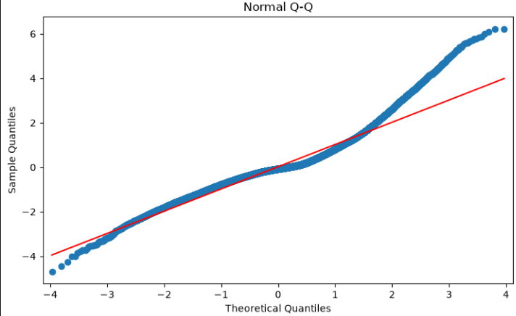
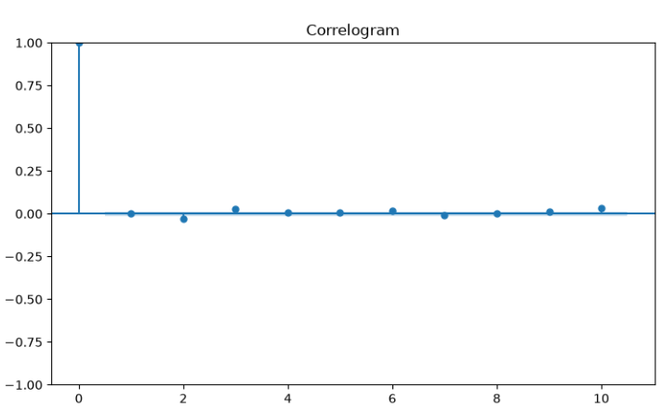
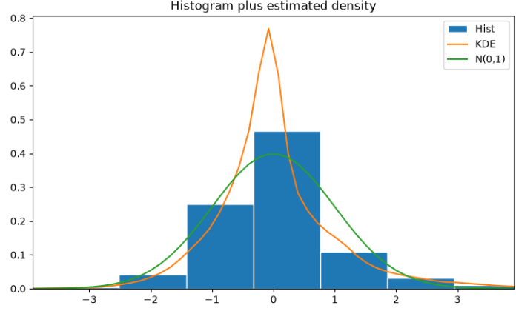
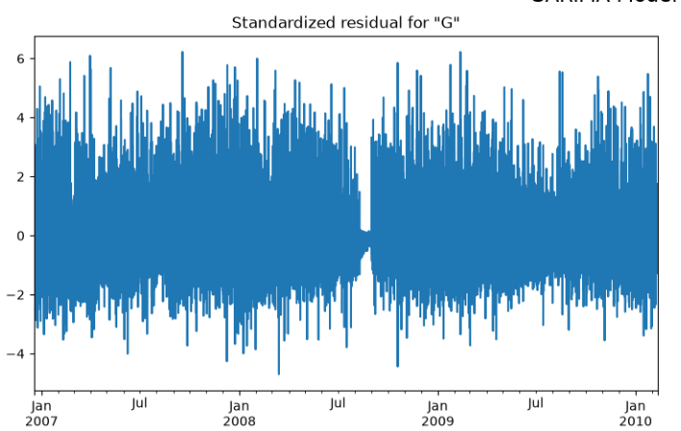
FORECASTING - VALIDATION
Residual Diagnostics Support the SARIMA Fit
Standardized Residuals
Histogram & Q-Q Plot
Residual ACF (Correlogram)
Distribution Shape
Fluctuate randomly around zero with no remaining trend or seasonal pattern — the model captured both components.
The data are approximately centered around the theoretical distribution but show substantial tail deviations from normality. The pronounced S-shaped pattern indicates skewness and heavier-than-normal tails.
Autocorrelations sit within confidence bounds at nearly every lag - little structure left unexplained.
A slight right skew indicates that most observations are concentrated around the center, with a few larger positive values extending the right tail. This suggests occasional positive deviations from the overall distribution.
10

Slide 12

SUMMARY
Key Takeaways
Distinct usage regimes exist
Consumption is daily-seasonal
K-Means on Kernel PCA features cleanly separates Very Low through High consumption hours (silhouette 0.78).
STL and ACF/PACF confirm a strong 24-hour cycle layered on short-memory, stationary behaviour.
SARIMA is the right forecast model
Peaks remain the hard part
Seasonal terms cut RMSE from 0.74 to 0.69 kW and flip R² positive versus plain ARIMA.
Diagnostics show a well-fit model overall, but sudden high-usage spikes are still under-predicted.
11

Slide 13




CONCLUSION
Business Impact
Reduce Operating Cost
Better demand predictions help companies use their resources more efficiently, reducing unnecessary operational costs.
Household consumption regimes support targeted tariffs, energy-saving programs, and personalized customer engagement.
Understand Customers Better
Forecasting future electricity demand helps utility companies plan electricity generation and avoid power shortages
Promote Energy Efficiency
Better Energy Planning
High electricity users can receive personalized recommendations to reduce energy consumption, lower electricity bills, and support sustainable energy use.

